Slide 1
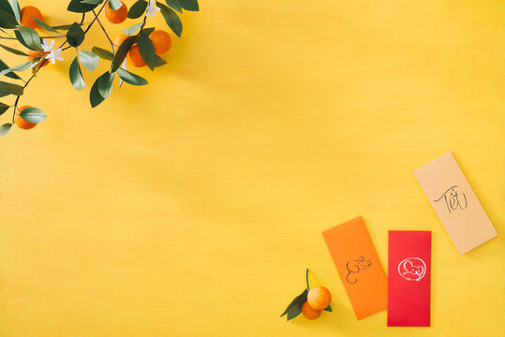
UNIT 8: CELEBRATIONS
A. READING

Slide 3
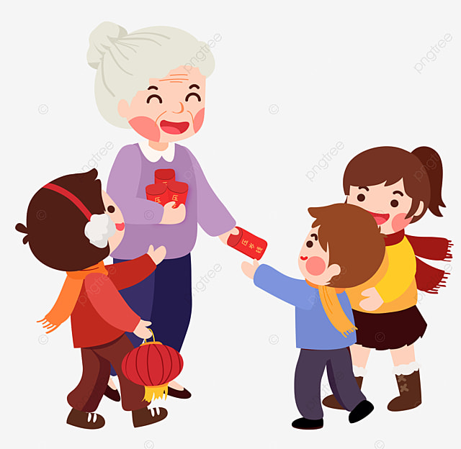
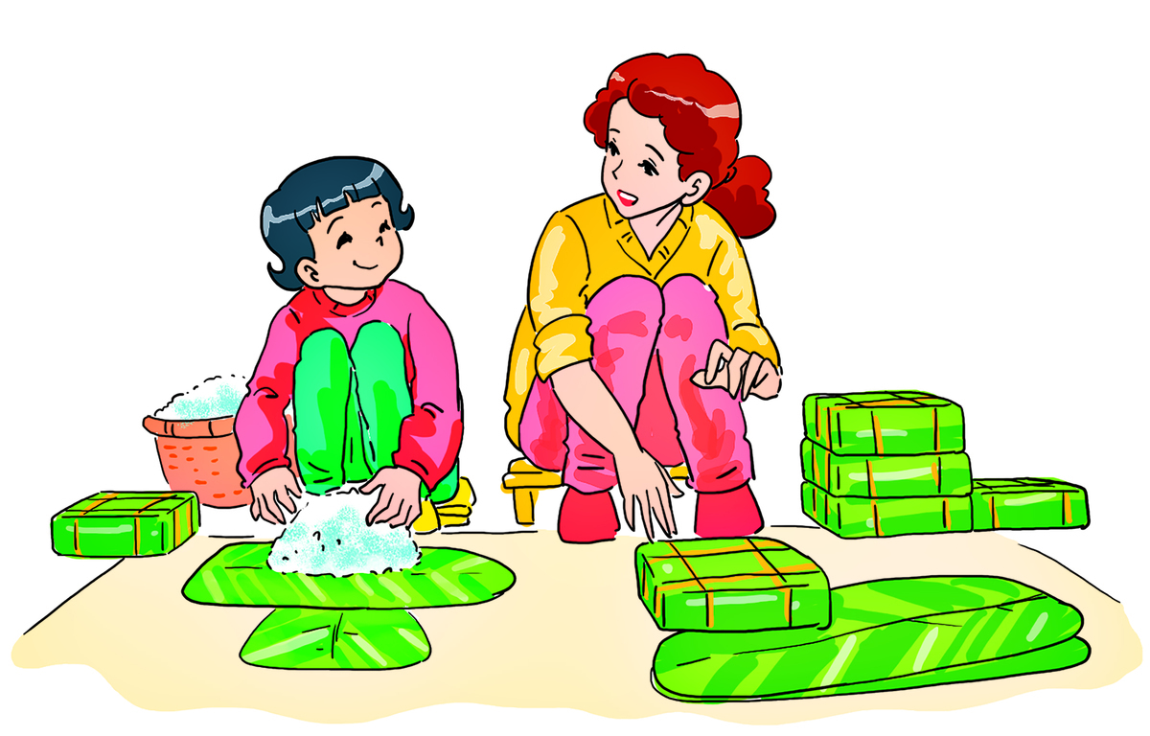
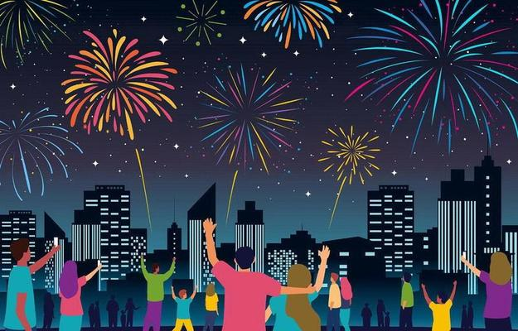
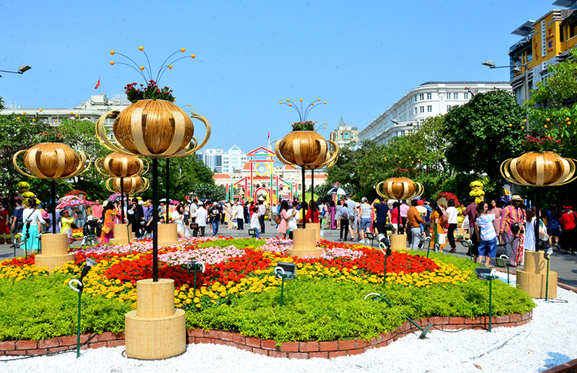
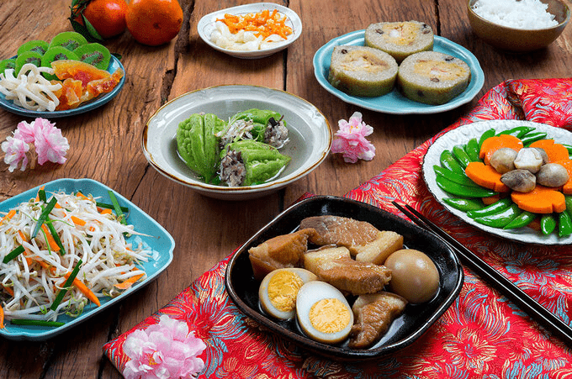

Slide 4
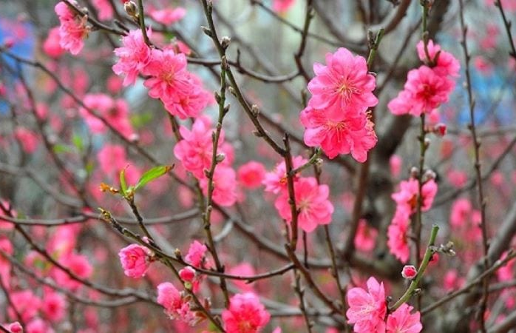
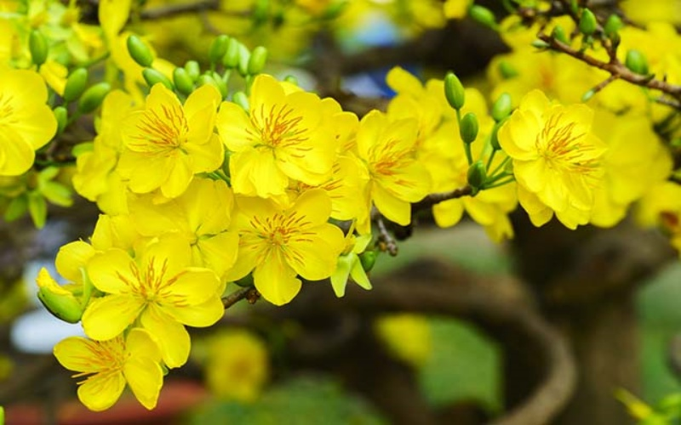
apricot blossom (n)
/ˈeɪprɪkɒt ˈblɒsəm/
peach blossom (n)
/piːtʃ ˈblɒsəm/

Slide 5
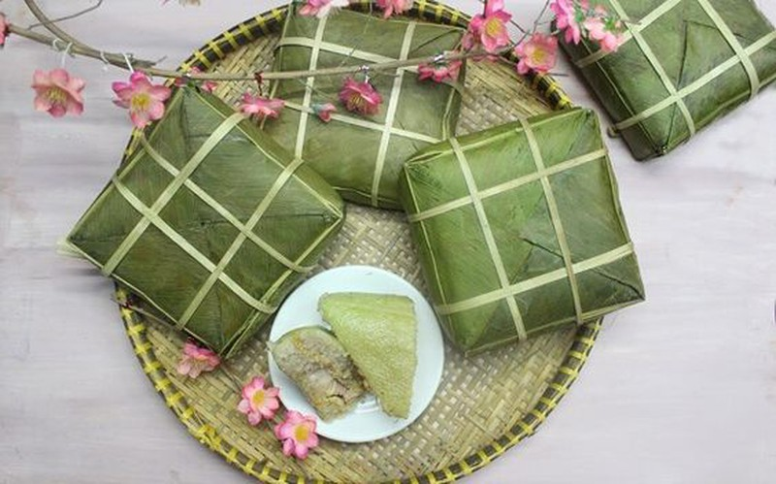
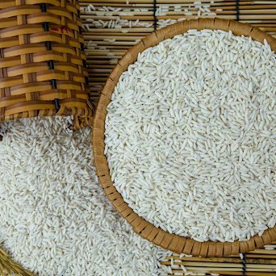
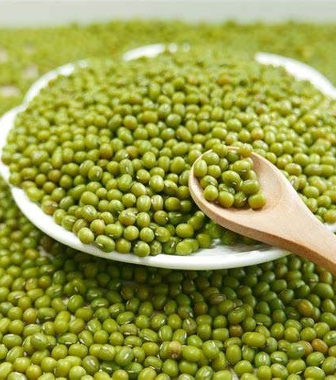
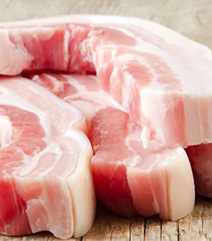
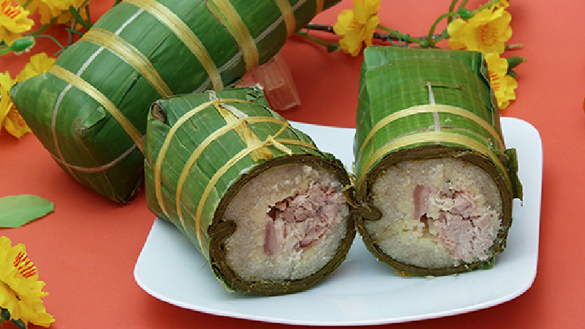
green bean (n)
fatty pork (n)
sticky rice (n)
/ɡriːn biːn/
/ˈfæti pɔːk/
/ˈstɪki raɪs/

Slide 6
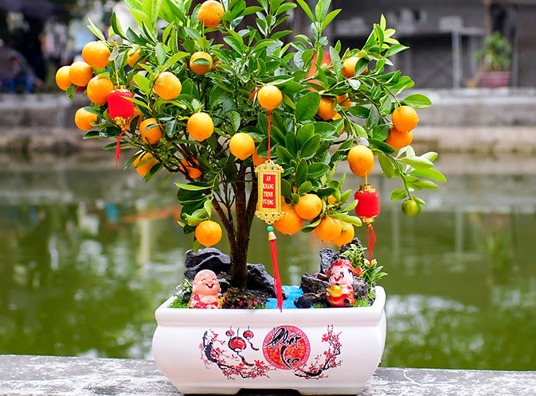
kumquat tree (n)
/ˈkʌmkwɒt triː/

Slide 7
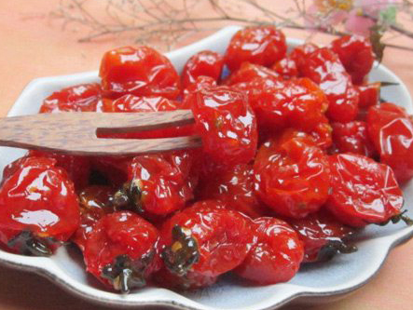
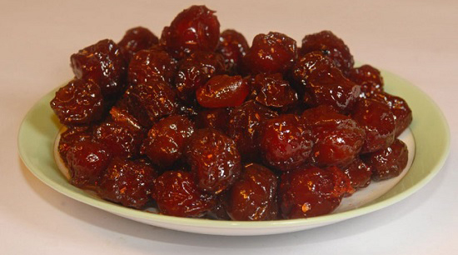
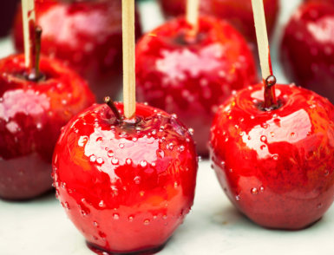
candied fruit (n)
/ˈkændid fruːt/

Slide 8
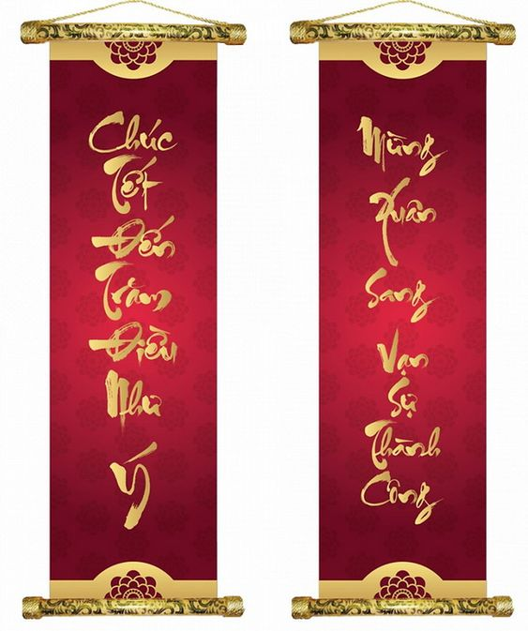
banner (n)
/ˈbænə(r)/

Slide 9
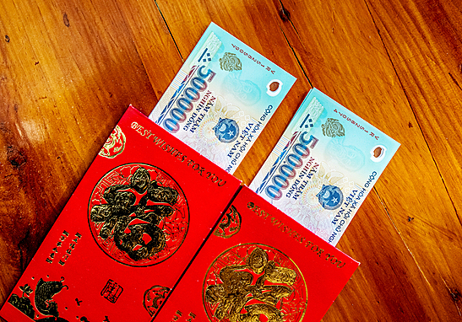
lucky money (n)
/ˈlʌki ˈmʌni/
envelope (n)
/ˈenvələʊp/

Slide 10
agrarian /əˈɡreəriən/ (a)
thuộc nông nghiệp
→ agrarian people = farmers = peasants
grand /ɡrænd/ (a)
hoành tráng, quan trọng

Slide 11
apricot blossom (n)
peach blossom (n)
green bean (n)
sticky rice (n)
fatty pork (n)
kumquat tree (n)
candied fruit (n)
banner (n)
envelope (n)
lucky money (n)
agrarian (a)
grand (a)
hoa mai
hoa đào
đậu xanh
nếp
thịt mỡ
cây quất
trái cây tẩm đường, kẹo trái cây
biểu ngữ
bao thư
tiền lì xì
thuộc về nông nghiệp
hoành tráng, quan trọng

Slide 12
Lunar New Year, or Tet, is Vietnam's main holiday. It is the grandest and most important occasion in the year which falls sometime between 19th January and 20th February on the Western calendar. Tet marks the beginning of spring and, for agrarian people, the start of a new year.
Tet’s preparations and celebrations used to be spread over months, but nowadays the holiday is much shorter. A great deal of excitement still builds up well before Tet. however. Streets are decorated with coloured lights and red banners. Shops are full of goods. People arc busy buying gifts, cleaning and decorating their houses and cooking traditional foods.
On the days of Tet everyone tries to be nice and polite to each other. People believe that what they do on the first day of the year will influence their luck during the whole year. Thus, only positive comments should be made. People visit other family members or friends, and they exchange New Year's wishes. Children receive their “lucky money" inside red envelopes. Many people go to pagoda to pray for a happy year for themselves and their family. Both children and adults take part in games and various forms of entertainment. Tet is really a time of fun and festivals throughout the country.
Homes are often decorated with plants and flowers at this time. Peach blossom is traditional at Tet in the North while apricot blossom is traditional in the South. The kumquat tree with its ripe deep orange fruits is popular throughout the country. One of Tet’s most special foods is banh chung, which is made from sticky rice, green beans and fatty pork. Mut, which is candied fruit such as sugared apples, plums or tomatoes, is also popular.

Slide 13
Lunar New Year, or Tet, is Vietnam's main holiday. It is the grandest and most important occasion in the year which falls sometime between 19th January and 20'¹' February on the Western calendar. Tct marks the beginning of spring and, for agrarian people, the start of a new year.
Tet’s preparations and celebrations used to be spread over months, but nowadays the holiday is much shorter. A great deal of excitement still builds up well before Tet. however. Streets are decorated with coloured lights and red banners. Shops are full of goods. People are busy buying gifts, cleaning and decorating their houses and cooking traditional foods.
Homes are often decorated with plants and flowers at this time. Peach blossom is traditional at Tet in the North while apricot blossom is traditional in the South. The kumquat tree with its ripe deep orange fruits is popular throughout the country. One of Tet’s most special foods is banh chung, which is made from sticky rice, green beans and fatty pork. Mut, which is candied fruit such as sugared apples, plums or tomatoes, is also popular.
On the days of Tet everyone tries to be nice and polite to each other. People believe that what they do on the first day of the year will influence their luck during the whole year. Thus, only positive comments should be made. People visit other family members or friends, and they exchange New Year's wishes. Children receive their “lucky money" inside red envelopes. Many people go to pagoda to pray for a happy year for themselves and their family. Both children and adults take part in games and various forms of entertainment. Tet is really a time of fun and festivals throughout the country.

Slide 14
TASK 1: Decide whether the statements are true (T) or false (F)
T F
1. Tet is always on 20th February on the Western calendar.
2. According to the text, for people anywhere in the world the beginning of spring is the start of a new year.
3. Tet used to be longer than it is nowadays.
4. According to the text, “lucky money” is given to everyone at Tet.
5. Kumquat trees are popular both in the North and in the South of Vietnam.
6. People try to be nice and polite to each other because they want to have good luck on New Year’s Day.
sometimes between 19th January and 20th February
✓
agrarian people
✓
✓
children
✓
✓
✓
during the whole year

Slide 15
TASK 2: Answer the following questions.
1. How long did Tet preparations and celebrations last in the past?
2. What do streets look like before Tet?
3. What do people often do to prepare for Tet?
4. What is banh chung made from?
5. What is mut?
6. What are some popular activities at Tet?

